Slide 1
Dallas restaurant Analysis
Data Science Capstone Project

Slide 2
Problem statement
This report contains an analysis for new restaurant location in Dallas Metro Area in Texas, USA. The client is interested in understanding different types of restaurants available in the Dallas metro area and looking for recommendations identifying the best place to open a new restaurant.
With an estimated 2019 population of 1,343,573, it is the ninth most-populous city in the U.S. and the third largest in Texas. Over 41 colleges and universities are located within its metropolitan area, which is the most of any metropolitan area in Texas. The city has a population from a myriad of ethnic and religious backgrounds and one of the largest LGBT communities in the U.S.

Slide 3
Data acquisition
Demographic data can be obtained via "https://neighborhoods.dmagazine.com/" whereas location data (coordinates) can be obtained using geocode.

Slide 4
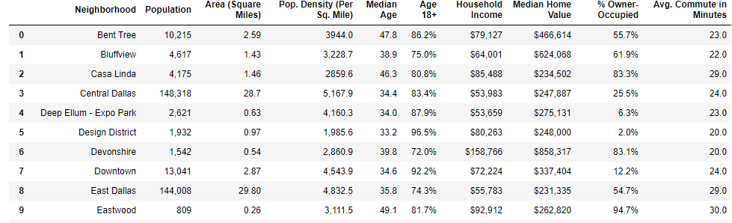
Data gathering
Scraping webpage to store data as pandas dataframe

Slide 5
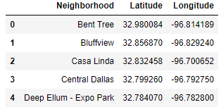
Location Data
Using geocode to obtain coordinate data for Dallas neighborhood as shown in slide #4

Slide 6
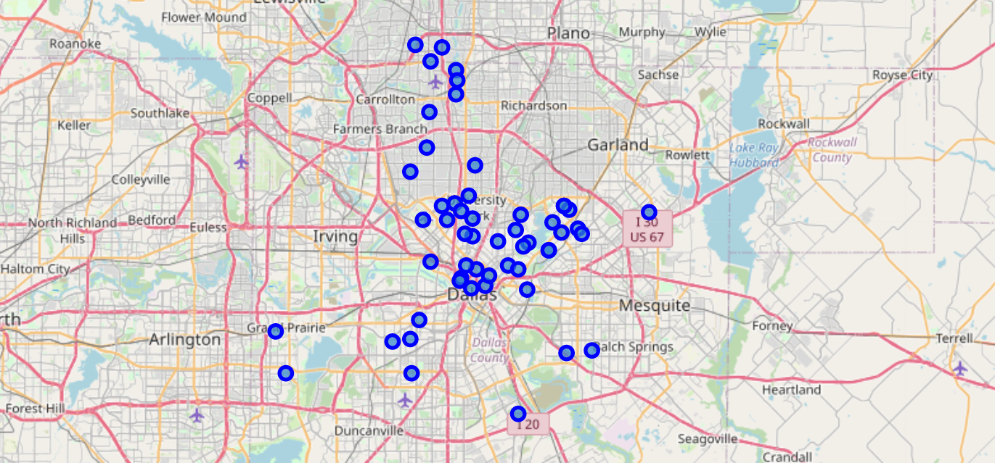
Dallas map
Map of Dallas Metro neighborhoods

Slide 7
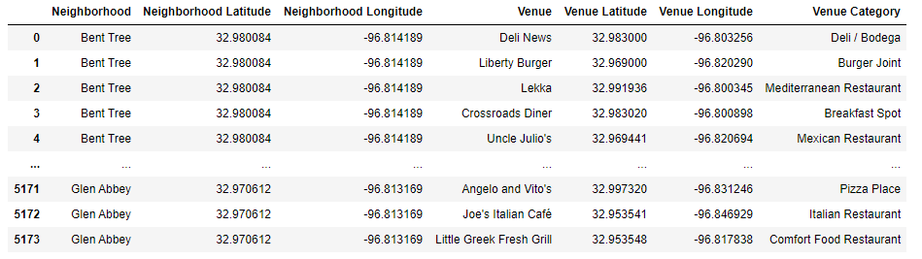
Foursquare api
FOURSQUARE API is used to pull venue(s) information for each Dallas Neighborhoods. Refer to jupyter notebook for the code.

Slide 8
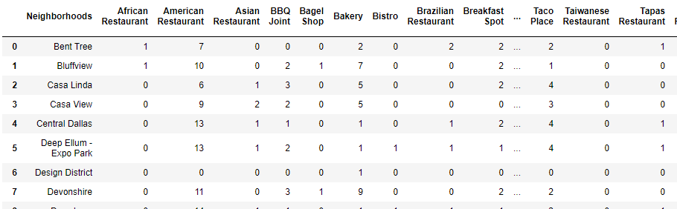
One-hot encoding
Converting venue categories as columns against neighborhoods to understand the types of restaurants in each location.

Slide 9
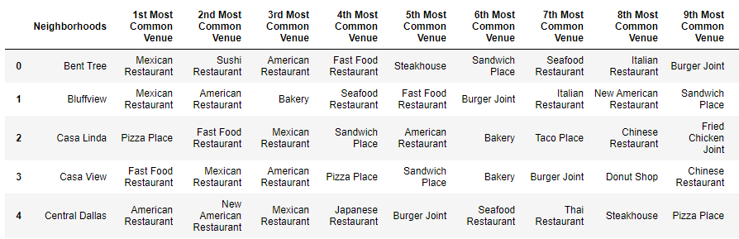
Most common venues
Understanding which type of restaurants are most common in each neighborhood. This will help identify what kind of restaurant should be opened in each part of the town.

Slide 10
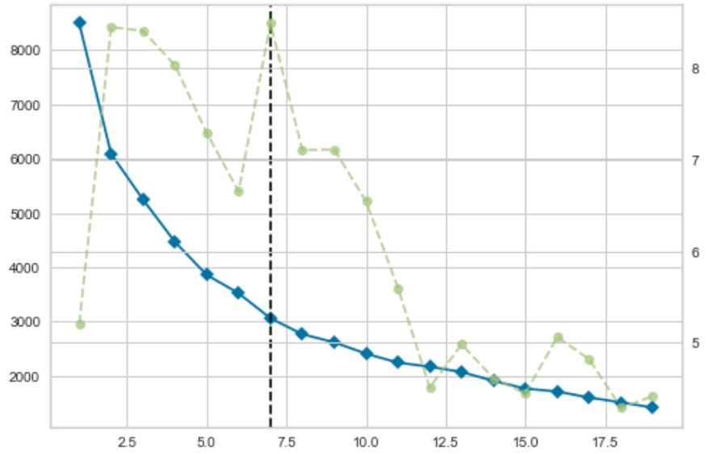
K-means clustering
Finding optimum K for clustering dataset

Slide 11
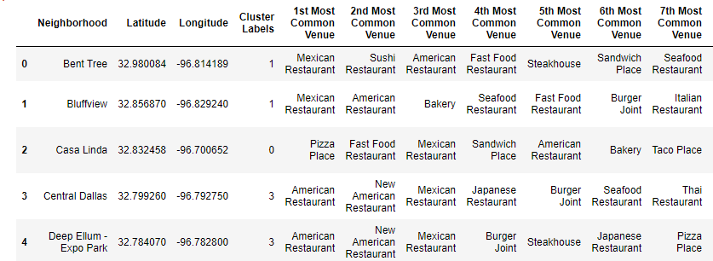
Clustering dataset
Matching cluster labels to the dataset so they can be plotted on a map

Slide 12
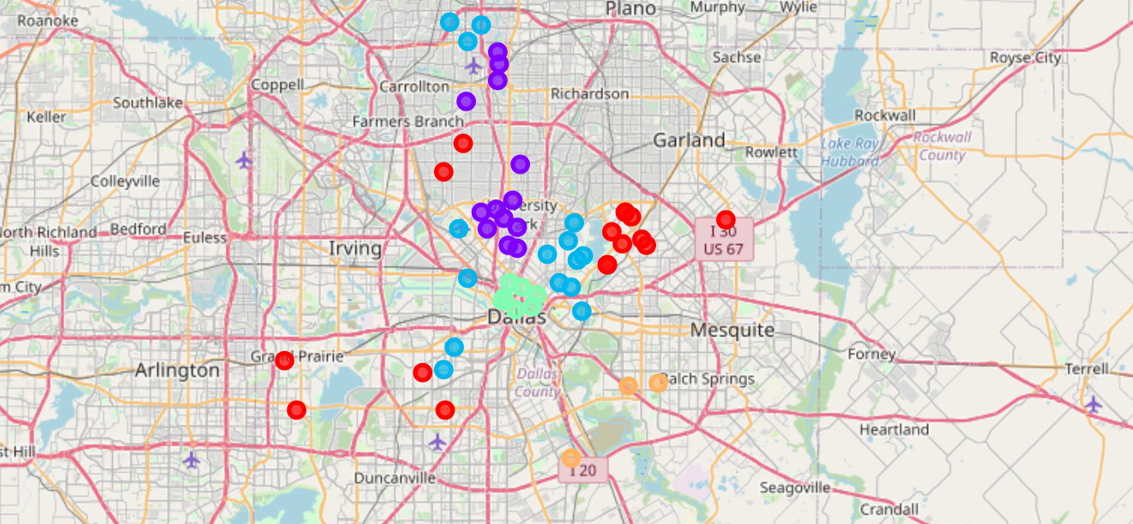
Restaurant cluster map
Map of clusters in Dallas, TX

Slide 13
conclusion
As represented in the above maps, best place to open a new restaurant based on location data available would be the SOUTH side of Dallas city. This is because there isn't a high concentration of restaurants available there and would make a suitable place to inaugurate a new restaurant.
As with any study, there are limitations to this analysis. One of the biggest missing component is the Socio-Economic-Status (SES) of the neighborhoods. That would deterime whether if would make business sense to operate a high end restaurant in areas where average income is less than $50,000.

